Slide 1
HUMAN RIGHTS, HUMANITARIAN LAW AND ITS RELEVANCE TO SCRES 1325
Linda Engvall
linda.engvall@indevelop.se

Slide 2
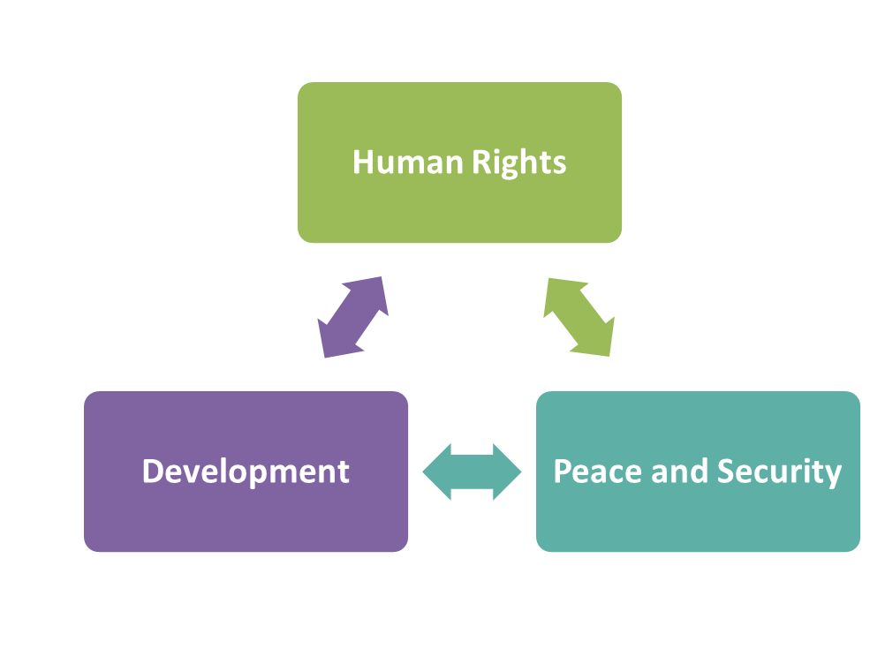
“We will not enjoy development without security, we will not enjoy security without development, and we will not enjoy either without respect for human rights.”
UN SG report 2008
In Larger Freedom
Notes:
When the human rights agenda was revitalized in the UN under Kofi Annan, the UN SG linked development, security and human rights his report ”In larger Freedom”. All modern UN PKO have a human rights unit. All UN PKO must respect human rights and humanitarian law. In 2013, UN issues a Human rights due diligence policy on United Nations support to non-United Nations security forces. Before support is given, an assessment of the risks involved in providing or not providing such support, in particular the risk of the recipient entity committing grave violations of international humanitarian law, human rights law or refugee law. A/67/775–S/2013/110.

Slide 3
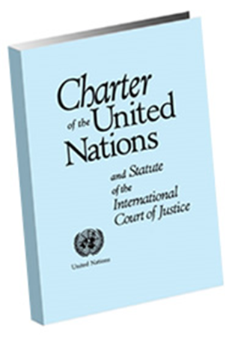
USE OF FORCE IN THE UN CHARTER
THE BASIC RULE – NO FORCE, UN Charter Art. 2
All members shall refrain from threats or use of force against the territorial integrity or political independence of another state.
The UN may not intervene in matters that are within domestic jurisdiction of a state, except under Ch VII
Exception – USE OF FORCE
Individual or collective self-defence, Art 51.
Force authorised by Security Council under Ch VII.
Responsibility to Protect?
Notes:
Preamble to the Charter, it is stated that one of the fundamental aims behind the founding of the Organisation was “to ensure, by the acceptance of principles and the institution of methods, that armed force shall not be used, save in the common interest”, and in its coupling with the later reservation in Article 51 that nothing in the Charter “shall impair the inherent right of individual or
collective self-defence”.
The law of self-defence is controlled by the principles of neccessity an disproportinality, since the Caroline Incident in 1841. The treat of force and use of force is on equal par in the UN Charter, if the use of force would be illegal, the treat of such force would also be illegal.
The Responsibility to Protect (R2P or RtoP) is an emerging norm that sovereignty is not a right, but that states must protect their populations from mass atrocity crimes—namely genocide, crimes against humanity and war crimes. The R2P has three foundation "pillars":
1. A state has a responsibility to protect its population from genocide, war crimes, crimes against humanity, and ethnic cleansing.
2. The international community has a responsibility to assist the state to fulfill its primary responsibility.
3. If the state manifestly fails to protect its citizens from the four above mass atrocities and peaceful measures have failed, the international community has the responsibility to intervene through coercive measures such as economic sanctions. Military intervention is considered the last resort.
The question of military intervention under the third pillar of R2P remains controversial. Several states have argued that R2P should not allow the international community to intervene militarily on states, because to do so is an infringement upon sovereignty. Others argue that this is a necessary facet of R2P, and is necessary as a last resort to stop mass atrocities. A related argument surrounds the question as to whether more specific criteria should be developed to determine when the Security Council should authorize military intervention

Slide 4
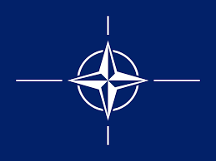
UN CHARTER
Security Council
Mandate: maintain international peace and security
Means: Resolutions (decisions by SC)
Chapter VI – Pacific settlement of disputes
Negotiation, mediation, arbitration
Monitoring cease-fire
Chapter VII – Threats to international peace
Art 41 – sanctions
Art 42 – authorization of use of force
Chapter VIII - regional arrangements
enforcement of UN SC decision
Notes:
All UN member states must respect the UN Charter. The main purpose of the UN as articulates in Article 1 of the Charter is to maintain international peace and security, develop friendly relations amongst nations, achieve international cooperation and respecting human rights.
There are five principal organs of the UN and the most important for us today is the UN SC, obviously because it adopted 1325, but as it has the primary responsibility for the maintenance of international peace and security.
Two chapters of the UN Charter regulate SC actions, chapter 6 and chapter 7.
Chapter 6 deals with the pacific settlement of disputes. This can be negotiations, mediation and arbitration. SC has also used Ch 6 to set up the old style of peace operations which entailed primarily monitoring of cease fires, such as UNFICYP (Cyprus), UNIFIL (Lebanon).
Chapter VII gives the SC its teeth because it authorises the use of force. The UN Charter states that all Member States agree to accept and carry out SC decisions (art 25), so in theory all SC decisions are binding. However, action under Chapter VI requires the cooperation of the states involved and cannot be enforced without consent of the state. Under ChVII, in exceptional circumstances, SC can take decisions on the use of force against a member state, even without the consent of the member state. This requires the agreement of at least the permanent members of the SC, which is often contentious as we see today in the case of Syria (decisions require 9 out of 15 members yes, including permanent five).

Slide 5
UN SC MANDATES FOR PEACE OPERATIONS
Chapter VI | Chapter VII | Chapter VII
Peacekeeping | Peacekeeping | Peace Enforcement
Traditional monitoring, observation of ceasefires | Multidimentional PKO, Protection of Civilians | Authorised armed intervention
Consent of parties to conflict. | Consent of parties to conflict. | Consent not required.
No use of force, except in self-defence | SC can authorise use of force at the tactical level with consent of host nation and/or parties to the conflict. | SC authorised use of force without consent of main parties, which may involve use of military force at strategic or international level.
UNFICYP (Cyprus) | UNMISS (South Sudan), MONUSCO (DR Congo) | ISAF (Afghanistan), Operation Desert Storm (Iraq), Korea
Notes:
This may authorise NATO or coalition troops to use force, which is very sensitive. It is of course preferable that the states involved give consent. Modern day UN PKOs with complex mandates of protection of civilians have a mandate under Ch VII, but are always established with the consent of the host country. The nomal policy for UN PKO is to not use force except in self-defence and in defence of the mandate. However, you may have notices that the most recent extension of MONUSCO’s mandate authorised an intervention brigade to take offensive operations to neutralise rebels in eastern DRC.
The General Assembly may also adopt resolutions on peace and security, but these are recommendations (Art 11).
[Backup info - compare: UNFICYP mandate: “in the interest of preserving international peace and security, to use its best efforts to prevent a recurrence of fighting [between the Greek Cypriot and Turkish Cypriot communities] ….
UNMISS mandate: Determining that the situation faced by South Sudan continues to constitute a threat to international peace and security in the region, Acting under Chapter VII of the Charter of the United Nations]
The right of UN forces to use force in self defence and defence of the mandate is NOT just under chapter VII mandates. This is established in UN practice and doctrine (Capstone Doctrine – since 1973 self defence has been deemed to include resistance to attempts by forceful means to prevent the peace-keeping force from discharging its duties). However, as Chapter VI mandates rely on the (continuing) consent of the parties – it may not be politically expedient to use force even if it is legally permissible to do so. (LINK to ROEs!)
UN peacekeeping operations are not an enforcement tool. However, they may use force at the tactical level, with the authorization of the Security Council, if acting in self-defence and defence of the mandate.
Examples of multidimensional peace operations:
• United Nations Mission in the Democratic Republic of Congo (MONUC);
• United Nations Stabilization Mission in Haiti (MINUSTAH);
• Hybrid United Nations African Union Mission in Darfur (UNAMID);
• United Nations Mission in the Central African Republic and Chad (MINURCAT);
• United Nations Mission in the Sudan (UNMIS);
• United Nations Operation in Cote d’Ivoire (UNOCI);
• United Nations Mission in Liberia (UNMIL).
Examples of peace enforcement operations authorized by the Security Council, but carried out by regional organizations or coalitions:
• NATO-led Kosovo Force (KFOR), authorized by Security Council Resolution 1244 in 1999 to establish a safe and secure environment in Kosovo;
• United States-led Unified Task Force (UNITAF), authorized by Security Council Resolution 794 in 1992 to establish a secure environment for humanitarian relief operations in Somalia;
• ECOWAS-led Multinational Force in Liberia, authorized by Security Council Resolution 1497 in 2003 to help establish and maintain security after the departure of President Charles Taylor, in Security Council Resolution 1497 (known as ECOMIL which was later replaced by the UN peacekeeping operation, UNMIL).

Slide 6
GUIDE TO UNDERSTANDING SC RESOLUTIONS
Preamble
Background
Operational paragraphs
Important
Numbered
Words
Affirm – reaffirm
Stresses - encourages
Requests
Decides

Slide 7
RELEVANT INTERNATIONAL LAW
Human Rights
Humanitarian law/Law of Armed Conflict
Refugee law
International Criminal Law
Notes:
There are four areas of public international law relevant to women in armed conflict. We will focus on IHL and HR. Refugee law is based on the 1951 refugee convention and its 1967 protocols. It brings protection to refuges, which is a person who has left his or her country out of ”well founded fear of persecution”. There have been significant advances in recognising GBV as a type of persecution but I will not go further into this area here.

Slide 8
HR vs IHL
HUMAN RIGHTS | HUMANITARIAN LAW
Applies always for everyone | Applies during armed conflict
Regulates the relationship between the State (duty bearers) and people (rights holders) | Regulates the relationship between States and/or parties to conflict
Protects all human beings by virtue of being alive in the world | Protects those who do not, or no longer, take part of hostilities
Most rights can be limited for security and must be balanced against other rights. Some rights are absolute (torture, slavery) | Cannot be limited
Notes:
Applies always – be aware that some states (for example, the United States and Israel do not hold this position)
This table generalises, but provides the main differences.

Slide 9
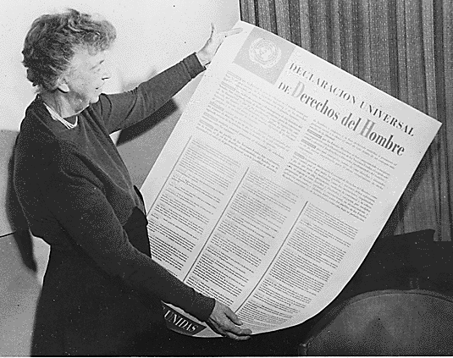
HUMAN RIGHTS LAW
Universal Declaration of Human Rights, 1948
The first international agreed principles of human rights
Adopted by the General
Assembly by States from all
regions of the world
States (duty bearers) should
Promote
Protect
Fulfill
Notes:
Principles of respect for dignity are evident in all cultures and religions, but it was first in 1948 the UN General Assembly adopted the first list of universally agreed human rights. Although the UDHR is a non-binding list of principles it is the basis of subsequent human rights instruments. Includes right to life, liberty and security, prohibition of torture, prohibition of arbitrary arrest, right to fair trial, the right to be presumed innocent before proven guilty
The UN then proceeded to develop specific human rights conventions, that were more specific and binding upon those state that ratify. Today, there are nine core human rights conventions (many more). When working in a new country, it is important to check the status of ratifications to these conventions.

Slide 10
NINE CORE HR CONVENTIONS
CERD – Racial Discrimination, 1966
ICCPR – Civil and Political Rights, 1966, and Optional protocol on abolition of death penalty
Fair trial – equality before the law
Basic standards of arrest and detention
Freedom of expression
ICESCR – Economic, Social and Cultural Rights, 1966
Right to free basic education
Right to access quality health care
Right to food, housing, safe drinking water
Notes:
1 – Prohibition of discrimination is found in every single convention. In the backdrop of post-colonialism, racial discrimination became the first human rights convention
From the unity in the world post WW II, in the adoption of UDHR, the cold war broke out and there was a disagreement between the block of the most important human rights. This led to the adoption of the two covenants.
2 – The ICCPR includes the right to life, prohibition of torture and slavery, right to liberty and security, basic standards for arrest and deprivation of liberty, fair trial, presumption of innocence, equality before the law. It does not mention women, but ”everyone”... And therefore includes women's access to fair trial and equality before the law, which may be very different from such access by men. Likewise, freedom of expression for women comes with very different dynamics. ICCPR does state that no-one should be forced to marry and that men and women have equal rights to marry, during marriage and in divorce.
3 – ICESCR includes labor rights, the right to education (a right, not a privilege, for girls and boys. Realizing the right to education for girls is crucial to gender equality and participation of women in public life). The right to health, there is a right for women to access quality health care. Right to food and housing.

Slide 11
CEDAW – Convention on the Elimination of all forms of Discrimination Against Women, 1979
Women’s rights are human rights!
Affirmative action to eliminate gender discrimination
Reproductive rights
Women’s health
Labour rights
Participation in political life
Education for women
Prohibits forced marriage, equal rights to divorce
Special protection for rural women
Notes:
4 – CEDAW – women's rights! Places a positive obligation on states to eliminate gender discrimination, including affirmative action. Specific provisions on reproductive rights, women's health, labor rights, participation in political life, education for women, prohibits forced marriage and gives equal rights to divorce and specific protection for rural women. 187 ratifications. You will have a dedicated session on CEDAW this afternoon, so I will not go into details here.

Slide 12
CAT - Torture and other cruel, inhuman or degrading treatment or punishment, 1984
CRC - Rights of the Child, 1989
Optional Protocol on Children in Armed Conflict (2000)
Optional Protocol on the Sale of Children, Child prostitution and child pornography (2000)
ICRMW – Rights of Migrant workers, 1990
CRPD - Rights of persons with disabilities, 2006
CED - Protection from Enforced Disappearances, 2006
Notes:
5 - CAT provides an absolute prohibition of torture in all circumstances, including in war, terrorism etc., torture is never ever allowed. This right can never be restricted and forms part of customary law.
6 – The core principle of CRC is the ”best interest of the child”. Focus on education, health, prevention of violence and sexual abuse but also recognition of freedom of expression. Only three countries in the world have not ratified the CRC (US, Somalia and South Sudan). The CRC have two very important Ops (additional treaties). OPCAC prohibits states and armed groups from using girls and boys under 18 as taking direct part of hostilities and from forced recruitment of children to armed forces. (It recommends that states do not recruit children at all, but sets the hard limit at participation in hostilities). It includes obligations on demobilisation, rehabilitation and social reintegration. The other OP specifically prohibits sale of children (including irregular adoption) child prostitution and child pornography and places an obligation on states to criminalise such acts and take all measures, including effective prosecution.
Migrant Workers, a serious issue in Iraq
Persons with disabilities may include persons who have lost limbs in war
Enforced disappeances – background military junta in south america.

Slide 13
DEROGATIONS
Most human rights can be limited, if this is
Provided by law
For the purpose respecting other human rights
Meets the “just requirements of morality, public order and the general welfare in a democratic society.” (UDHR)
Some human rights concepts are absolute and can never be limited even in times of war, such as genocide, slavery and torture
Notes:
Read

Slide 14
SOFT LAW
Declaration on the Elimination of Violence against Women
The Code of Conduct for Law Enforcement Officials
UN Guidelines for the prevention of Juvenile Delinquency
Standard Minimum Rules for the Treatment of Prisoners
Notes:
The UN has developed numerous documents that serve as guidance, though specifying existing principles. They are non-binding.

Slide 15
UN HUMAN RIGHTS MECHANISMS
Treaty Bodies
Under each convention a committee, recommendations
Special Procedures
Individual or group appointed by HRC with thematic or country mandate, f.ex Special Rapporteur on Violence against Women
Universal Periodic Review
Peer-review by states, all states, all human rights, every four years
Notes:
Quick slide.
The UN human rights mechanism have three main monitoring mechanisms.

Slide 16
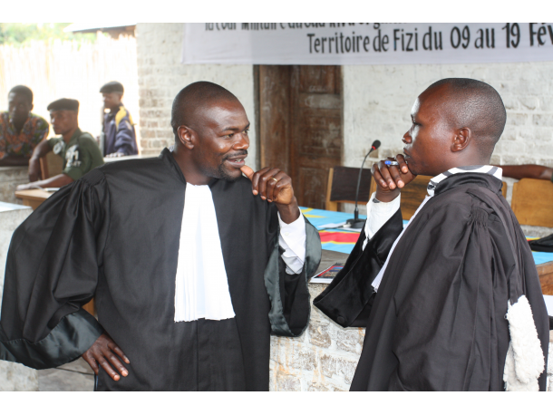
NATIONAL AND REGIONAL MECHANISMS
National examples
Independent Human Right Commission, Ombudsman
HR Committee in Parliament
Ombudsmen
Judiciary, traditional courts
Civil Society
Regional
African Charter on on Human and Peoples’ Rights
European Charter on Human Rights
Notes:
Quick slide
It is most important and efficient to promote and protect human rights on the national level. In the field, it is useful to know what national human rights mechanisms and actors are available and which ones work in your region. When you encounter a potential human rights abuse, you will be better prepared to refer the case as appropriate or ask/provide further information as appropriate. The photo is from a mobile court session in the eastern Democratic Republic of Congo found nine soldiers guilty of rape and crimes against humanity, including the army colonel who ordered the attacks in the mountain top village of Fizi in South Kivu province. More than 50 women were sexually assaulted here in early January.
Africa and the Americas have well developed regional human rights mechanisms and conventions.

Slide 17
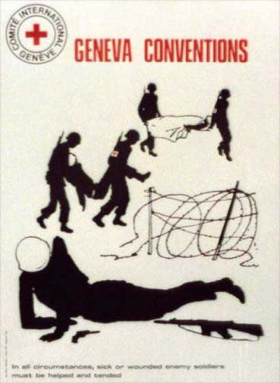
HUMANITARIAN LAW AKA. LAW OF ARMED CONFLICT
Geneva Conventions (1949)
Sick and wounded at war
Sick and wounded at Sea
Prisoners of War
Civilians
Common Article 3
Additional Protocols (1977)
Extended protection for civilians
Rules regarding non-international
armed conflict
Notes:
Humanitarian law was codified after WWI and is based on the four geneva conventions with its optional protocol, each designed to protect specific groups. AP II and article 3 or all conventions provides provisions for non-international armed conflicts.

Slide 18
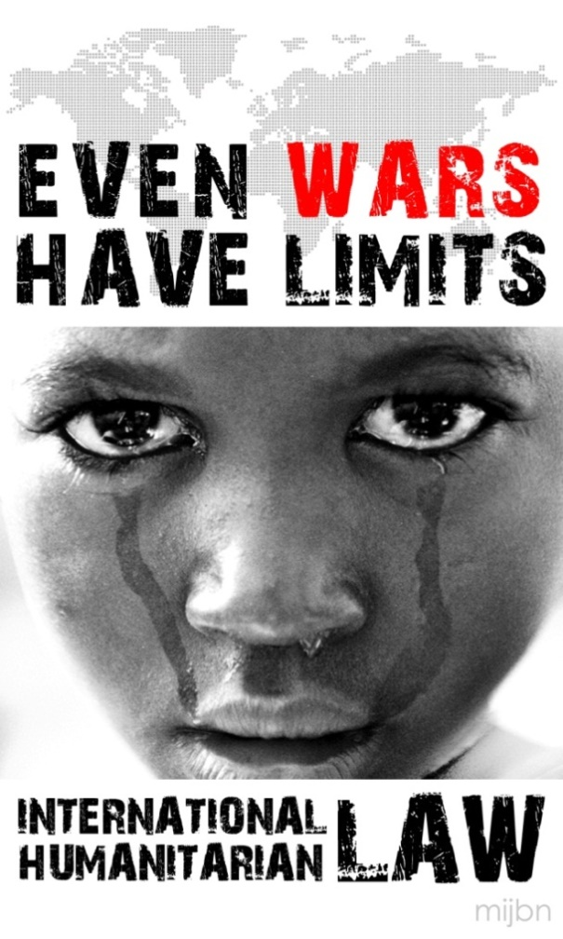
BASIC PRINCIPLES OF IHL
The principle of distinction between
civilians and combatants
The principle of proportionality
The principle of precaution in attack
Military necessity
The responsibility to protect (R2P)
Notes:
Distinction: The parties to the conflict must at all times distinguish between civilians and combatants. Attacks may only be directed against combatants. Attacks must not be directed against civilians.
Proportionality: Launching an attack which may be expected to cause incidental loss of civilian life, injury to civilians, damage to civilian objects, or a combination thereof, which would be excessive in relation to the concrete and direct military advantage anticipated, is prohibited.
Precaution: In the conduct of military operations, constant care must be taken to spare the civilian population, civilians and civilian objects. All feasible precautions must be taken to avoid, and in any event to minimize, incidental loss of civilian life, injury to civilians and damage to civilian objects.
Neccessity: Military necessity is governed by several constraints: an attack or action must be intended to help in the military defeat of the enemy; it must be an attack on a military objective and the harm caused to civilians or civilian property must be proportional and not excessive in relation to the concrete and direct military advantage anticipated.
The extent of R2P is still disputed. The Responsibility to Protect (R2P) is an emerging norm of responsibility to prevent grave violations of human rights and humanitarian law, which provides for three stages of responsibility to protect.
A state has a responsibility to protect its population from genocide, war crimes, crimes against humanity, and ethnic cleansing.
The international community has a responsibility to assist the state to fulfill its primary responsibility.
If the state manifestly fails to protect its citizens from the four above mass atrocities and peaceful measures have failed, the international community has the responsibility to intervene through coercive measures such as economic sanctions. Military intervention is considered the last resort. This last level is disputed, as it infringes on state sovereignty.

Slide 19
GENEVA CONVENTIONS &AP PRINCIPLES SPECIFIC TO WOMEN
Women shall be treated with all consideration due to their sex
Separate accommodations & hygiene facilities for women POWs & internees
Pregnant POWS or suffering from obstetrical disorder shall be repatriated immediately
Women shall be especially protected against [any attack on their honour, in particular] rape, enforced prostitution or any other form of indecent assault
Expectant mothers shall be the object of particular protection and respect
Notes:
In addition, the Geneva Conventions contain some 19 provisions granting specific protections to women. The conventions were drafted in 1949 and are reflective of the cultures in place at that time. While they are gender neutral in terms of the language of civilians and combatants, the special protections that relate specifically to women are generally in terms of their roles as mothers (either as pregnant women, nursing mothers or mothers in general) or for women as particularly vulnerable to sexual violence in armed conflicts. While rape is prohibited under the Geneva Convention (Art 27(2) GC IV) it is linked to the women's honour which has tended to take away from the seriousness of sexual violence as physical and psychological harm (NB – it was not included in the list of grave breaches). Note: the GC protections that are there are valuable but they are limited in terms of their view of women's experience of armed conflicts.
1977 protocols don’t change the attitude too much – Art 76 contains a comprehensive provision specifically protecting women against rape.
Rape and sexual violence is prohibited under customary international law
References to corresponding bullet points on slide:
(GCI&II, Common Art 12);
(GCIII Arts 25 & 29, GC IV Arts 49,85, APII art 5(2));
(GCIII Art 110);
GC VI, Art 27, API Arts 75&76(1))
GC IV, Art 16, API Art 76).

Slide 20
INTERNATIONAL CRIMINAL LAW
Genocide: Acts of violence with intent to destroy, in whole or in part, a national, ethnical, racial or religious group
Crimes against Humanity: Acts of violence, when:
Committed as a part of a widespread and systematic attack
Against the civilian population
Where the perpetrator had knowledge of the attack
War Crimes: Acts of violence that are “grave breaches” in the Geneva Conventions, such as torture, willful killing and the taking of hostages.
Notes:
ICL developed after WWII and deal with three main crimes; genocide, CAH and war crimes (also act of aggression). This is a development of humanitarian law and the convention against genocide, which have now become customary law. National court may deal with such cases if these crimes are included in national law. After the wars in former Yugoslavia and in Rwanda, the UN set up the ICTY and ICTY as international tribunals with a mandate to adjudicate on these crimes as they formed part of customary law.
The difference between these three crimes are the level of intent. War crimes are any serious breach of humanitarian law, CAH could be the same type of acts, but committed on a widespread and systematic level and genocide could be the same type of act but with a specific intent to destroy a group.
SGBV, rape, can be a way of committing these crimes.

Slide 21
THE INTERNATIONAL CRIMINAL COURT
Based on ratification of the Rome Statute
In its “Elements of Crime”, explicitly includes;
Rape
Sexual slavery
Enforced prostitution
Forced pregnancy
Enforced sterilization
Sexual violence
Persecution due to gender (CAH)
Notes:
As the ICC is now operational, we will se many more cases of SGBV prosecuted as international crimes. The ICC has explicitly includes the following acts as crimes which may constitute genocide, CAH and war crimes. In 2012, the ICC issued its judgement in the Lubanga case, where the congolese rebel leader was convicted of war crimes for the use of child in armed conflict, including using girls as sex slaves and forcing boys to rape.

Slide 22
SUMMARY
SC RES 1325 is supported by an extensive body of legally binding principles in human rights and humanitarian law.
The right to education, political rights and freedom of expression support women’s participation
Such principles have led to direct accountability through international criminal law.
Sexual violence is criminal under international law

Slide 23
https://www.youtube.com/watch?v=1e8xgF0JtVg

